Slide 1
Planning a Cover Crop System (West)
Notes:
Cover crops are a practice to consider when you are looking to implement a SHMS and help meet the SH principles

Slide 2

Objectives
Identify producer objective(s) and resource concern(s).
Identify and select cover crop species to address those concerns.
Integrating cover crop to compliment current cropping system.
Cover crop planting logistics.
Notes:
Planting/termination methods, the importance of recognizing life history traits, such as phenology/reproductive strategies, growth patterns, moisture requirements and how that’s management is key to understanding how and where cover crops fit within rotation and how to make sure we are mitigating the risks that may be associated with adding a cover crop into a production agriculture system where they might not have been before.
Picture: oats, cow peas, field peas, sunflowers
Needs pic source

Slide 3
Question
What are most common producer objectives that you encounter in working with cover crops in your region ?

Slide 4
Cover Crop Planning Support
Following questions are intended to guide a discussion with producer to help select a CC or mixes of CCs that best fits their needs. This along with site specific climate and soil data, will ensure best outcomes for your customer
For what identified resource concern/s is a cover crop being planned to address
What is the primary purpose of cover crop/s?(e.g. erosion control, increase SOM, suppressed weeds, increase infiltration & reduced compaction, capture nutrients, N fixation, increase biodiversity, etc. or multiple objectives
In what months does the producer want living cover crop/s
In what kind of cropping systems will cover crops be planted (e.g., annual: (vegetables, perennial: vineyard/orchard)
Where will cover crop/s be planted (e.g., whole field or row or raised beds)
Do any of the following to the planned site, e.g., salt issues, soil crusting, high N, low fertility, poor drainage, residual herbicides etc.
What production factors (e.g., disease/pest carry over, frost risk, planting/harvesting issues etc.)
Dr. Smither-Kopperl & Dr. Lowell
Notes:
Example questions to ask producer when planning cover crops

Slide 5
Cover Crop Planning Support
What equipment available to support the cover crop/s for the following –Planting, Termination, irrigation etc.
Where will a producer get cover crop seeds
Has the producer planted cover crops in the past? Any concerns
Things to consider:
In some perennial systems, growers are working in the field many times for activities such as harvesting, spraying, pruning, etc. It is critical to understand how cover crops may impact the ability to complete require activities, considering things such as:
How tall does a cover crop get? Does it affect producer activities?
How does it grow (upright, creeping, etc.)
How quickly will residue break down? Will it delay planting of following crops?
Is there risk of it becoming a weed issue if termination is not fully successful?
Smither-Kopperl & Lowell
Notes:
Cover Crops (340) and conservation cover (328) may serve similar purposes. In general, conservation cover includes perennial species as they are intended to persist for the lifespan of the practice (10 years), and may be more appropriate than cover crop in perennial system middles (e.g., between rows of trees and vines.

Slide 6
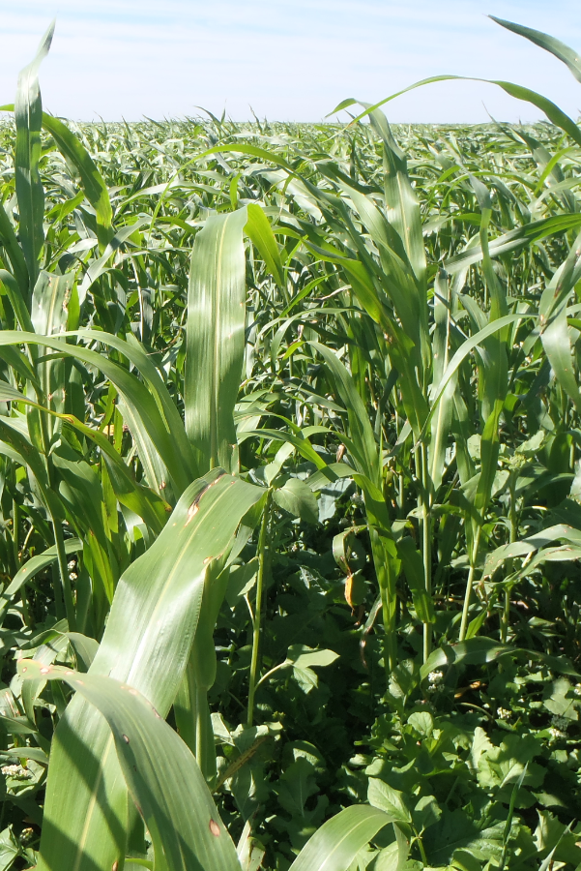
Cover Crop Intentions
Identify Resource Concerns & Producer Objectives
Crop diversity (habitat)
  To support additional biology
  Build or improve soil organic matter
  IPM/beneficial insects
  Livestock integration
  Wildlife winter food & shelter
Notes:
Make sure to refer to the purposes in the 340 standard. May have to take out Livestock Integration
.
You may change photo to local representation
Before listing the bulleted points on why we might convince a producer to include cover crops as part of their rotation, have the group chime in on why they might suggest incorporating cover crops into an operation? See how many of these points they can get!
Improve water cycle/availability HUGE purpose in dryland systems. Improve water infiltration, maybe trap and retain snow
C:N-high ratio: can rotate between high and low C:N species within rotation (brassica in corn stalk residue)
Livestock integration: sometimes the only way it is economically feasible to incorporate cc into a dryland system is to get that added revenue stream of integrating livestock into the system.
Photo courtesy of Dan Palic up in NE CO: turnip, forage radish, sorghum sudangrass, oats mix

Slide 7
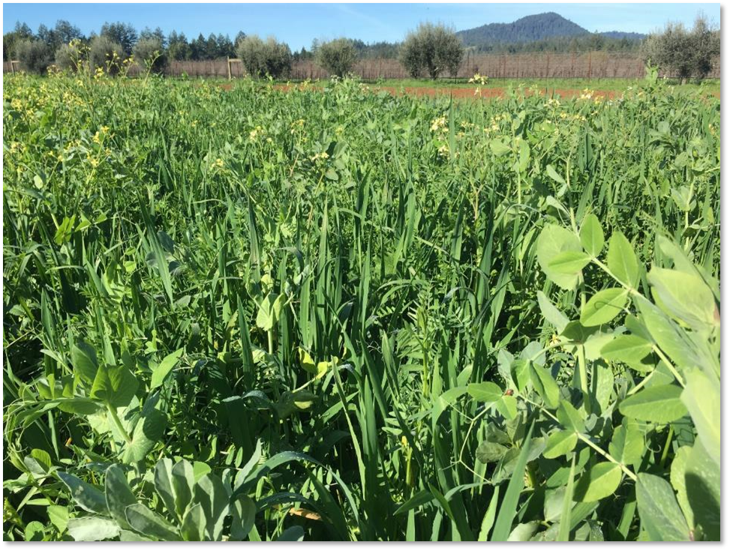
Cover Crop Intentions
Identify Resource Concerns & Producer Objectives
___________________________
Soil surface armor
  Build stable soil aggregates
  Improve water cycle/ availability
  Weed suppression
  Air Quality
  Erosion
Notes:
Resource concern is bold and following bullets are benefits from addressing the resource concern
Photo: Nathan Lowder NRCS

Slide 8
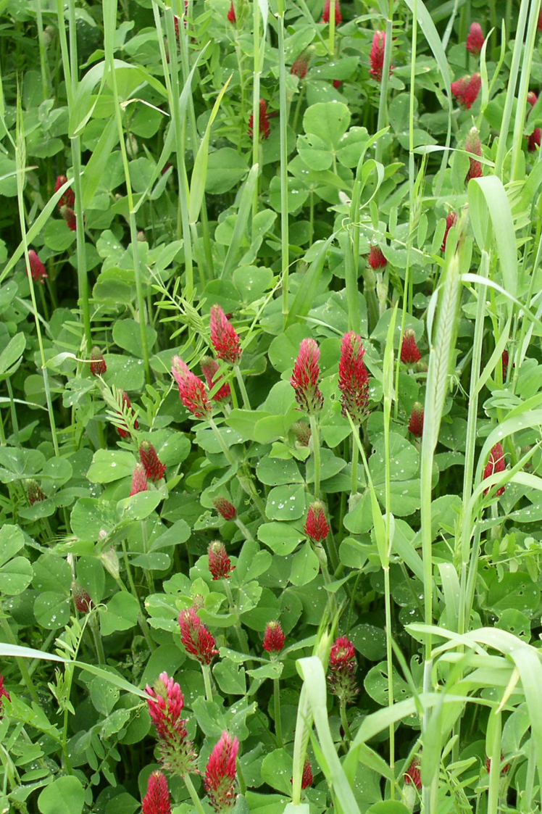
Cover Crop Intentions
Identify Resource
Concerns & Producer Objectives
__________________________
Nutrient cycling/ efficiency
  Adjust carbon/nitrogen ratios
  N fixation
  Retain excess nutrients
Notes:
Resource concern is bolded, Bullet statements address how to solve RC
Photo: Nathan Lowder NRCS

Slide 9
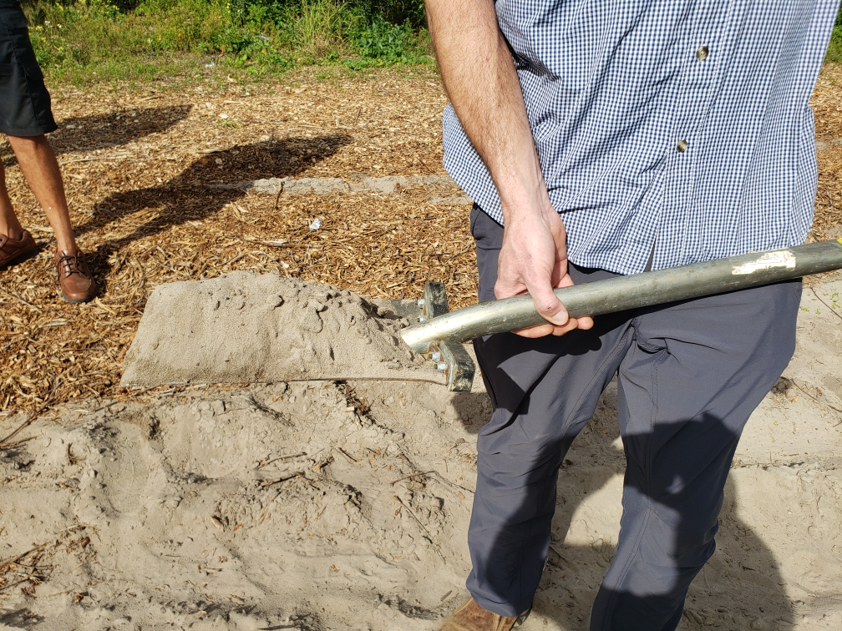
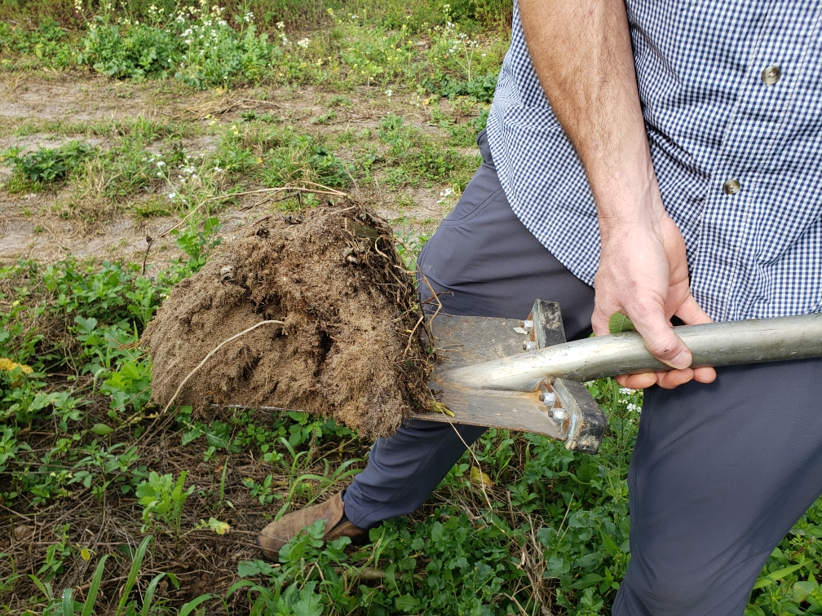
Soil Health Resource Concerns
Discuss producers’ achieved level of transition to SHMS
  Inventory soil health planning principles and practices
Determine level of soil function
  In Field Soil Health Assessment
  Soil Health Test Results vs. Benchmark
  Changes in cost of production
Notes:
Items to consider when planning cover crops in the SHMS
Photos show soil with and without cover crops in farming system
Photo: Nathan Lowder NRCS

Slide 10
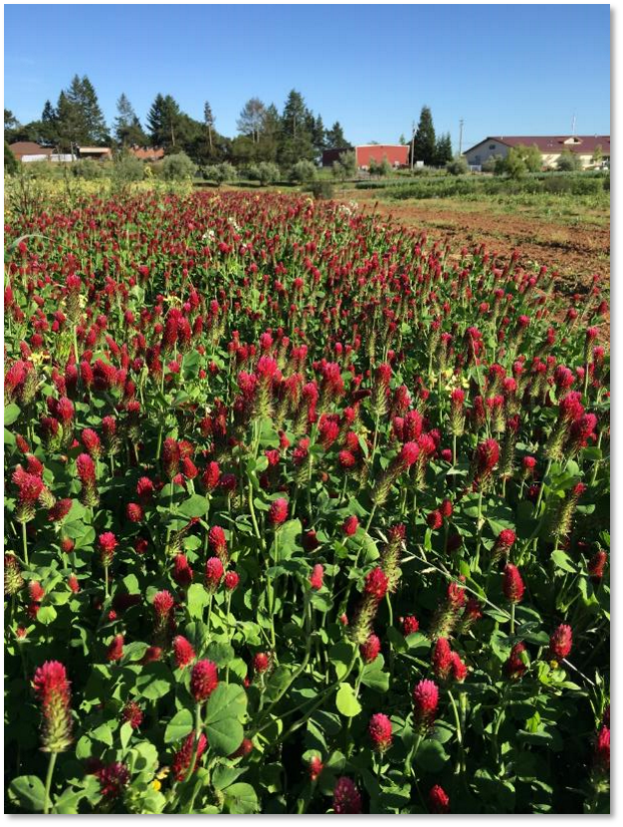
Cover Crop Considerations
for Successful Planning
Site preparation
Early weed control
Timing and species (adequate growing season)
Crop rotation/diversity
Seed quality (bin run, PLS, certified)
Seeding method seed-soil contact (broadcast vs. drilling)
Seed size/seeding depth
Legume inoculation
Moisture management (cover benefits, water use)
Producer’s goals
Remsberg, SARE
Notes:
You may change photo to local representation
Spend a little more time explaining as needed, as these are not explained in more detail later in the presentation:
Site preparation: same for all conservation seedings, need good seed to soil contact, ask questions like how much residue will you be planting into, what equipment does the producer have for seeding/terminating? Drill vs broadcast, will you be planting into a growing crop? How much moisture is available for my mix? Are the weeds adequately controlled? will there be any herbicide carryover that could affect cover crop?
Early weed control: get the cc in as early as possible to eliminate weed pressure
Crop rotation/diversity: consider incorporating all the plant functional groups into your rotation where possible. Understand that the more diverse the mix is, the harder it can be to manage. Consider combinations of cover crop mixes to achieve more objectives, however it is more cost effective to limit mixtures to species that will reliably achieve objectives than to try too many species at once. Can be a common misconception, sometimes a really well-developed mix that has 3 species is much more successful (and economically feasible) then a mix that has 17 different species

Slide 11

Identify Current
Cropping System
Monoculture or series of crops that are part of a rotation.
Examples: what are rotations in your area?
  2-year Winter Wheat, Potatoes
  Mixed Vegetable Crops – tomato, sunflower, melon, beans
  Perennials – Orchard / vineyard
Identify periods that do not contain cash crops
Assess producers' intentions, seeding windows and that growing season is adequate
Remsberg, SARE
Notes:
*****Find document that has typical rotations from across the US ask Marlon and Nick
*** Add Candy’s excel spreadsheet in the chat to identify windows
**Add local examples of seeding windows. When can the producer plant CC in his rotation? The easiest in most rotations is behind small grain crops.
Be aware of crop insurance implications, they seem to be a constant moving target
There may be short windows to grow cover crops ex. 60 days between cash crops to build diversity, scavenge nutrients, and suppress weeds.
These are the four major opportunities to seed cover crops in traditional cropping systems. Early spring, summer, late summer after crop harvest, fall

Slide 12
Questions
What are effective ways to determine the appropriate seasonal niche for a cover crop in a particular farming system?
Do you generally use CPS 328 Conservation Crop Rotation with CPS 340 Cover Crop?
Notes:
Ask questions

Slide 13
Plan Cover Crop to Compliment Next Crop
Experienced SHMS producers can get very detailed. Producers may select specific species ahead of certain crops.
  Example rotation: 2 yr Winter Wheat, Potato
    Cover crop following wheat harvests
      - Cool Season mix that favors nematode suppression (6-way mix)
      - Include grasses and broadleaf plants
      Grazing opportunity late fall / early winter
      Warm and cool season options
Notes:
In this rotation often potatoes are harvested pretty late in the year (october) so very limited opportunity to plant covers after potatoes. If harvest early potatoes there is a short window (never say never). However there is time to plant CC after wheat harvest both years, consider cc mixes that suppress nematodes if nematodes are identified as a pest

Slide 14
Plan Cover Crop to Compliment Next Crop
Experienced SHMS producers can get very detailed. Producers may select specific species ahead of certain crops.
  Example rotation: 2 yr. Corn silage, Wheat, Sugar beet
    Cover crop interseeded into corn (V4-6 stage)
      - Multi species mix
    Cover crop after wheat harvest
      - WS / CS mix containing equal components
      Consider Sugar beet cyst nematode suppression mix
    Cover crop after sugar beet harvest,
      Fall triticale and vetch mix
      - cut for silage then No till corn into triticale stubble
Notes:
There is opportunity to plant cc after corn silage harvest, cc that would over winter like a small grain vetch mix are a good option, great opportunity too plant cc after wheat, consider cc mixes that suppress sugar beet cyst nematode mix, Bullets are pretty straight forward for slide
WS warm season, CS cool season

Slide 15
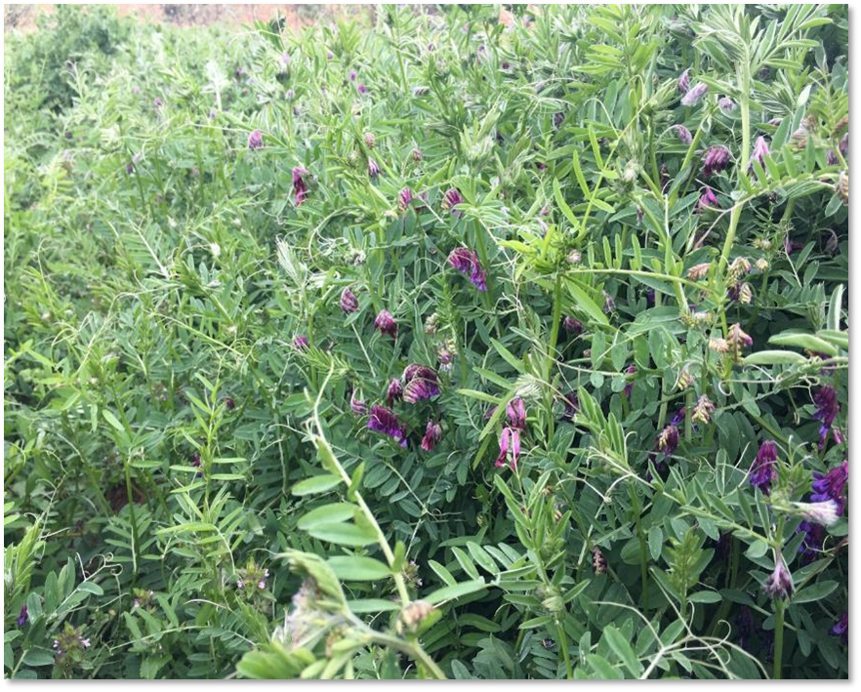
The Time to Plan is NOW!!!
  If planting early
    Understand expected residue accumulations and lasting cover
    Assess cash crop planting date to fulfilling the desired objective
  Common varieties often sell out quickly
    New varieties may not be in full production
Notes:
Discussion points with producer to consider C:N ration of cc, Plan early to buy seed as popular species sell out fast

Slide 16
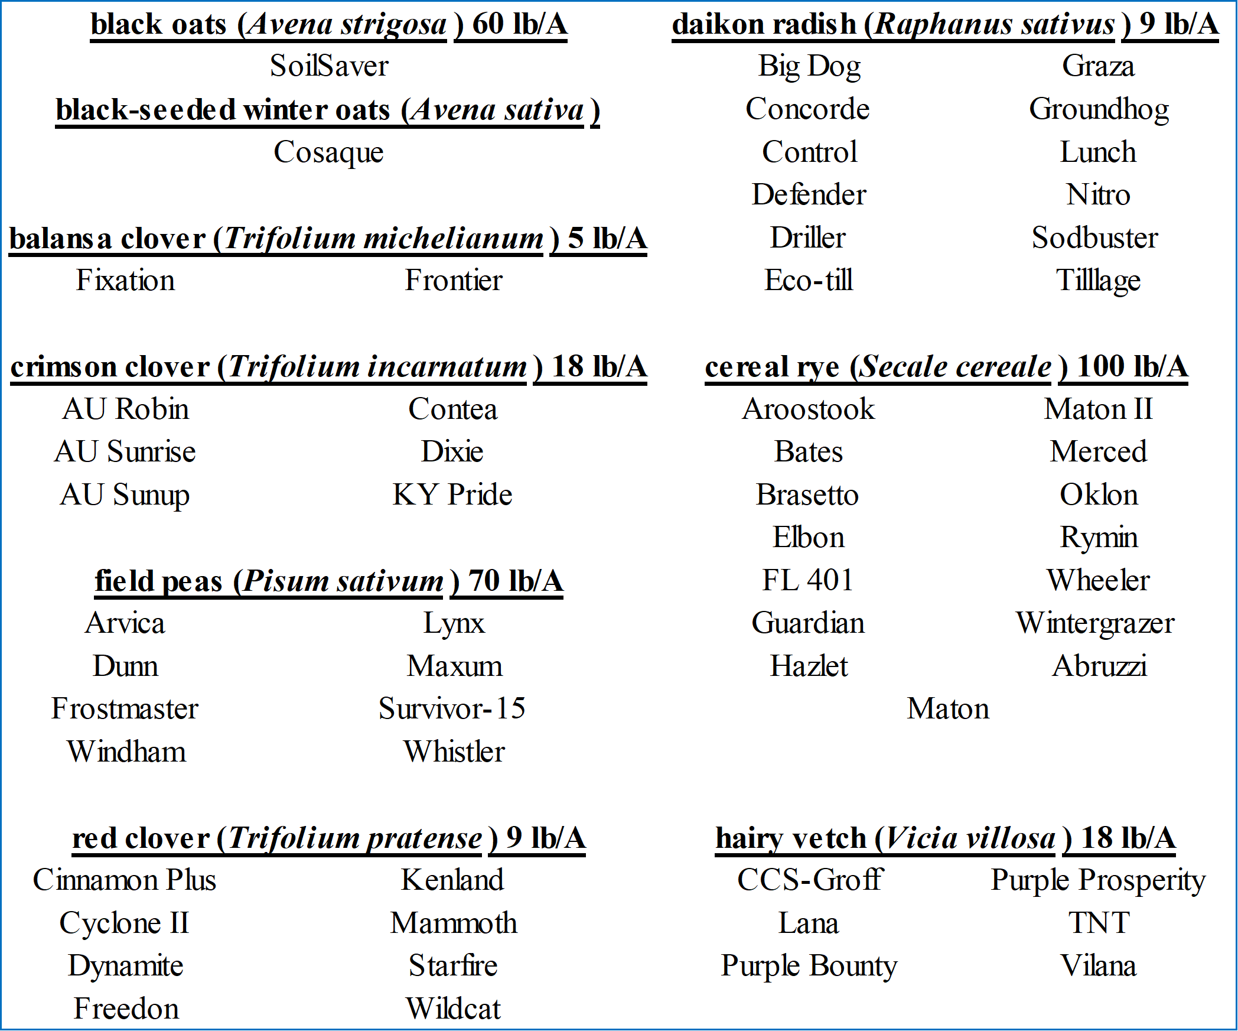
Find the Right Variety
Specific priorities and resource concerns may require specific varieties.
Cropping systems may only provide small windows.
Notes:
Can be critical depending on the species.
Especially if you are seeding annual ryegrass, ensure that you know the variety. Some species are extremely difficult to terminate.
If you have a variety that is identified, you are making a more informed decision and you have a better understanding of how that plant will behave which leads to better management and helps you meet your objectives.

Slide 17
What tools do you utilize to help select cover crop species and varieties?
Question

Slide 18


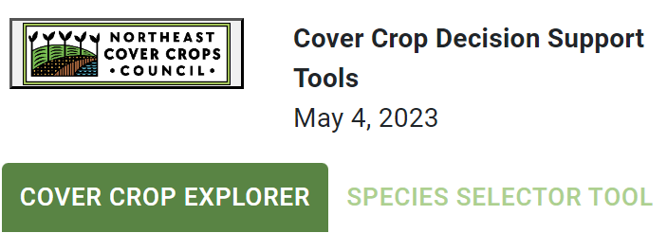
Selecting the right cover crop or mix
Utilize available planning tools
Start with State specific resources (IR)
Plant Materials Centers
VegSpec
Cover Crop Council Tools
  Cover Crop Decision Tool
  Species Selector Tool
  Cover Crop Explorer
  Cover Crop Nitrogen
  Calculator
Industry resources
Others?
Notes:
Ask question – what tools do we have available to help us select appropriate cover crop species?

Slide 19
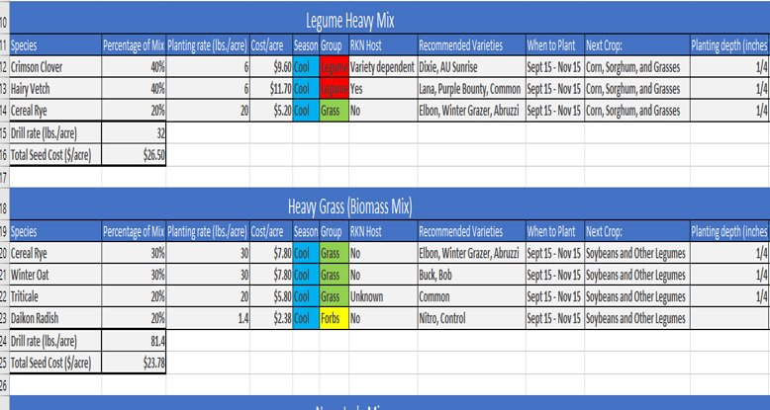
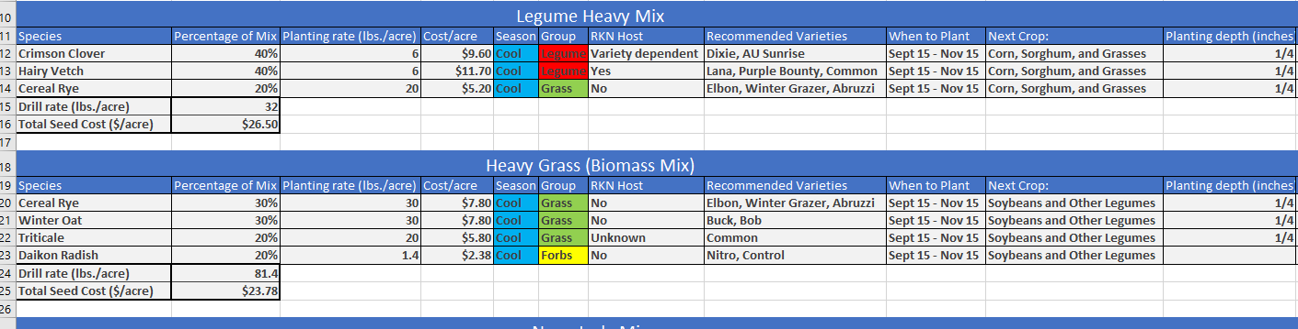
Seed Mix Calculators
https://efotg.sc.egov.usda.gov/api/CPSFile/30421/
Notes:
An example tool to use when developing cc mixes

Slide 20
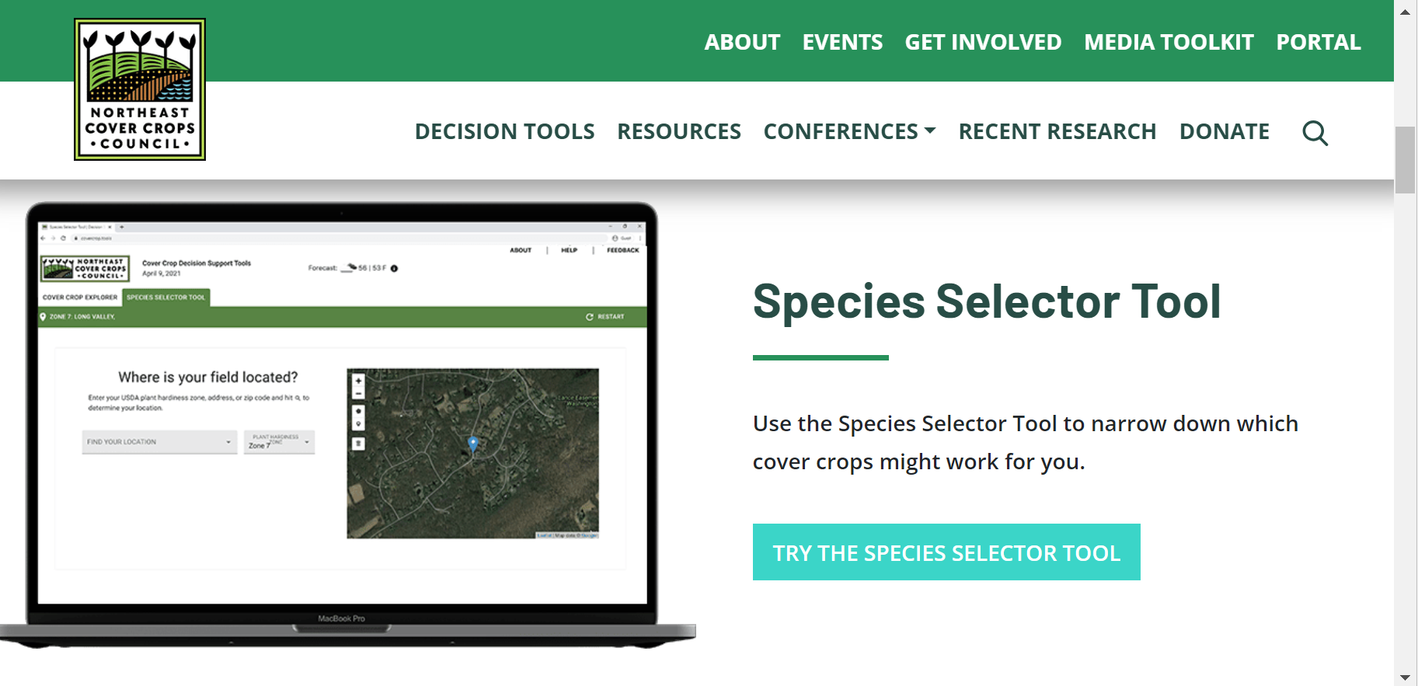

Regional Cover Crop Council Tools:
Full U.S. Coverage coming soon!
Notes:
Cc councils are developing tools to help when making cc mixes

Slide 21
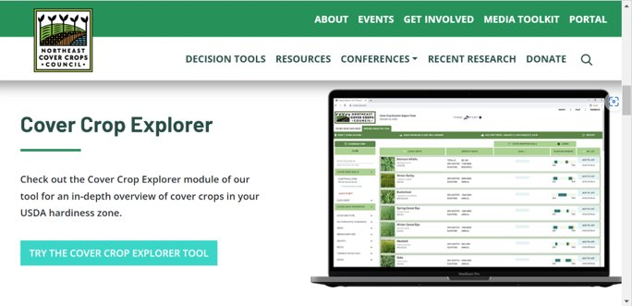
Notes:
Example cc tool from NECCC

Slide 22
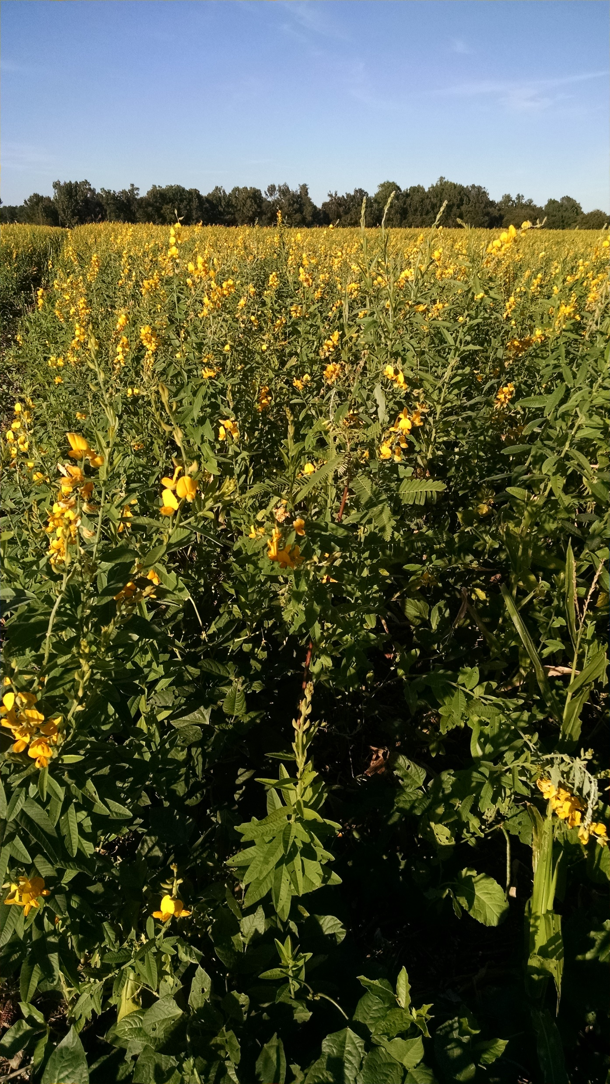
Assess and Select Species
Cover crop characteristics should address identified priorities and resource concerns
Growth cycle (perennial, annual)
Growth habit (upright or prostrate)
Root architecture (tap or fibrous)
Growth rate
Chemical composition (protein content, allelopathy)
Stress tolerance (drought, salt)
Time to flowering
Pest resistance or susceptibility
Notes:
Planners need to learn and understand about characteristics of cc including the following bullets

Slide 23
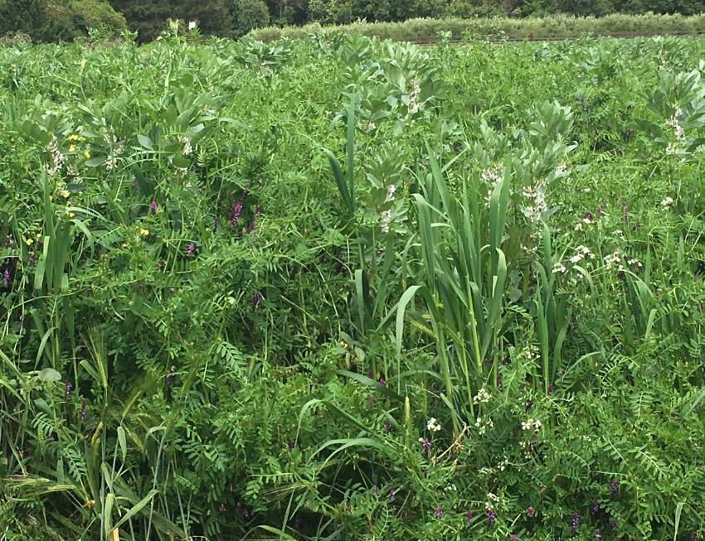
Matching Production System Factors ​
What other factors can be important for determining that suitability of a particular CC or variety for a specific site?
  Disease carry over
  Host of cash crop pest
  Residue at planting/harvest
  Positive impact on pollinators for cash crop
Notes:
Important bullets to consider when planning successful cover crops

Slide 24

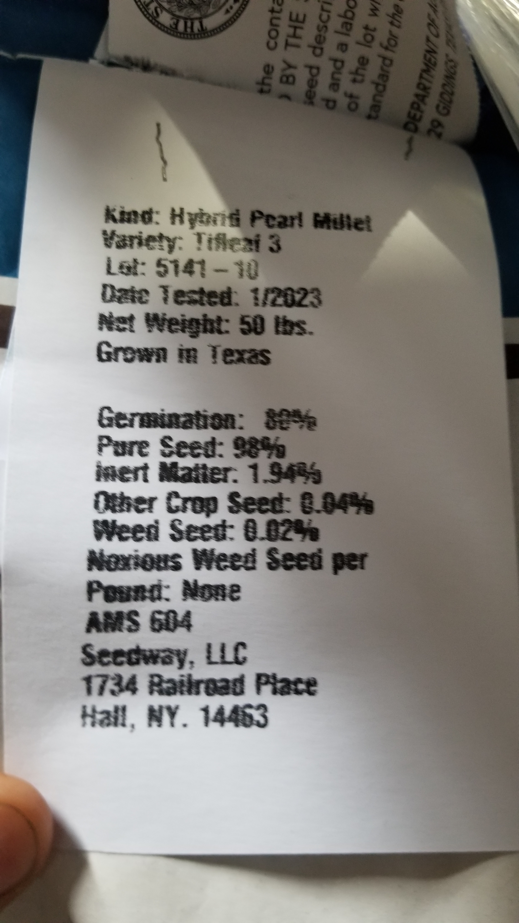
Certified Seed
% Pure Live Seed (PLS) = (% Germination + % Hard Seed)(% Purity)/100
% PLS = (80 + 0)(98)/100
% PLS = 78.4
Notes:
Calculating PLS based on seed tag

Slide 25
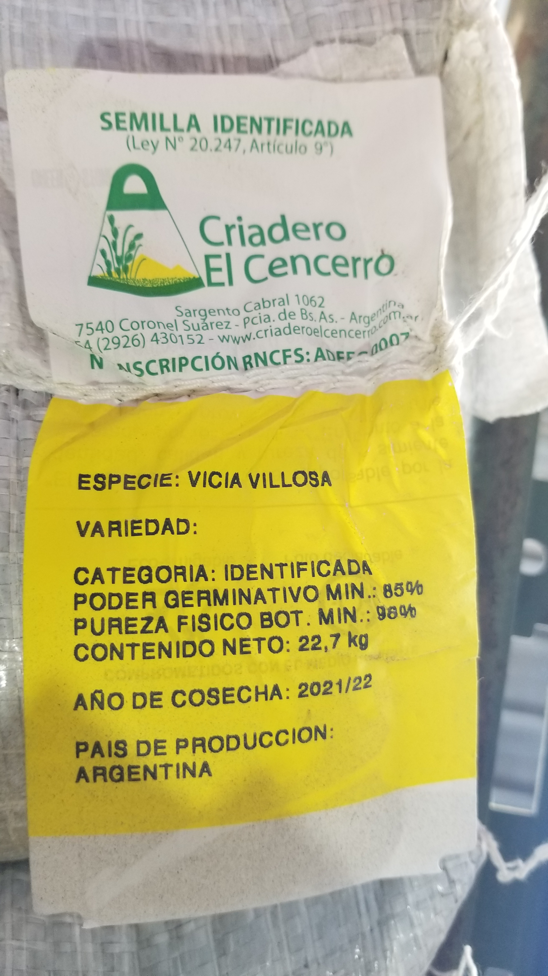
Seed that is (VNS)
Variety Not Stated
% Pure Live Seed (PLS) = (% Germination + % Hard Seed)(% Purity)/100
% PLS = (85 + 0)(99.51)/100
% PLS = 84.5
Notes:
Variety not stated seed tag and how to calculate PLS

Slide 26
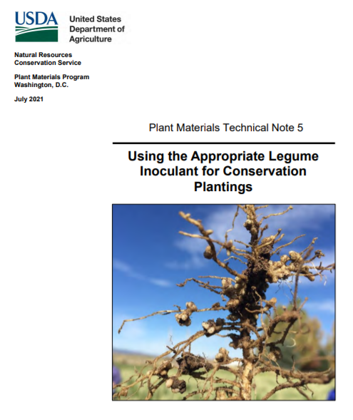
Legume Inoculation
Inoculants help improve the successful formation of nitrogen-fixing nodules in legumes
Inoculants are species specific
Inoculants are alive and have a maximum storage life
Keep inoculant refrigerated out of direct sunlight and
use prior to expiration date
Notes:
Notes to promote successful inoculation of legumes
Some seed companies are mixing a large group of inoculation together instead of individually

Slide 27
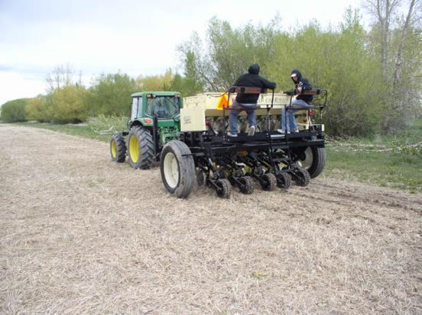
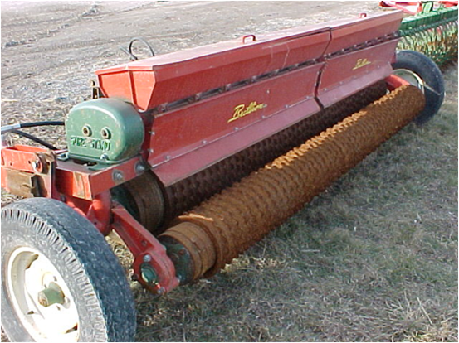
How will you seed it?
Drill
Aerial Broadcast
Ground Broadcast
Tillage Pass
Timing termination to allow for reseeding
Notes:
Options to seed the cover crop
5th bullet. In the southeast there are a few producers that allow the cover crop to mature enough to reseed so that they can minimize or eliminate annual seeding. Ex. ryegrass/crimson clover. cotton, peanut rotation, cover crop is cool season and it is to hot to germinate, so the cc waiting until the heat is over to germinate and grow, ie when cotton is nearly mature.

Slide 28
Questions
Who has observed good success with broadcast seeding in your work area?
What made it successful?

Slide 29
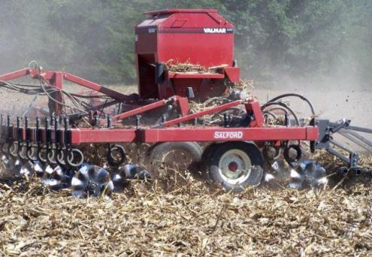
How will you seed it?
Equipment combinations
Minimize field passes
Combine other operations
  Residue management
  Fertility or amendment inputs
Notes:
Slide is self explaining
Combine other operations like doing some simple tillage and broadcasting cc seeds in one pass
Mix seed with fertilizer application

Slide 30
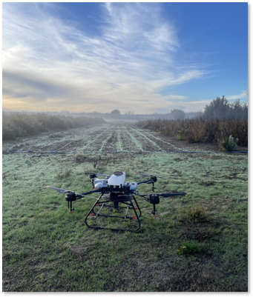
Aerial Seeding
Drones
  Commercial or producer applications
  Can be cost effective
  Lots of state and national specific regulations
    Permits
    Licenses
Notes:
When using drones be aware of permits and licenses
Can use airplane also

Slide 31
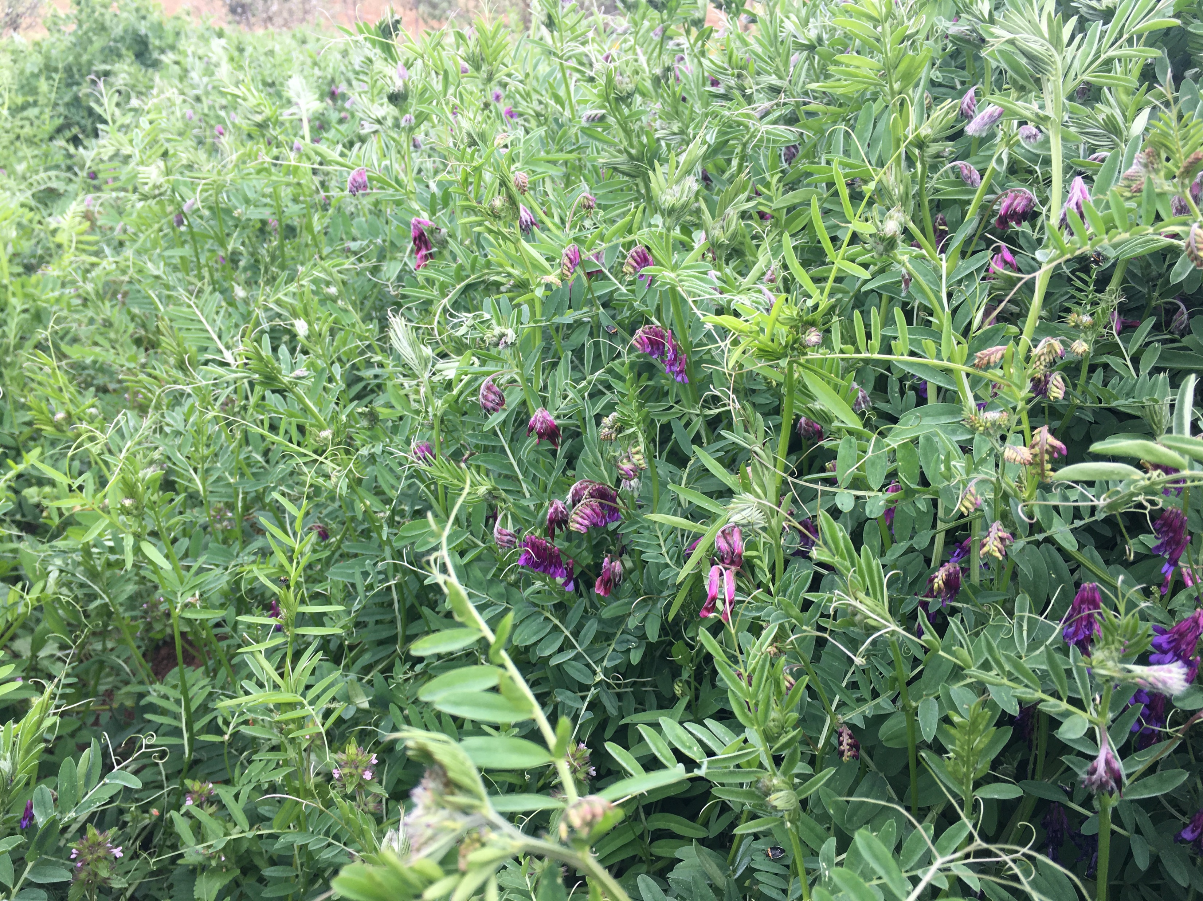
Planting for Success
Good Soil to Seed Contact is essential.
  Direct drill (correct seeding depth)
  Broadcast seeding (Harrow)
Consider Seed Size – seed planting depth ~x2 the diameter of the seed.
Plant at recommended seeding rate for species or mix.
Use good quality seed from a reputable seed dealer.
Calibrate the seeder!!!!

Slide 32
Reasons for Seeding Failure
Germination Through Emergence
After Emergence
  Poor quality seed
  Improper timing
  Temperature
    Too hot!
    Too cold!
  Improper planting depth
  Seed dries out, lack of moisture
  Crusted soil surface
  Toxicity
    allelopathic effects
    herbicide carryover
  Competition from weeds
  Low fertility
  Poor drainage
  Drought
  Insects
  Improper grazing by livestock
  Foraging by wildlife
  Diseases
  Winterkill
Notes:
Slide lists why the cc seeding failed

Slide 33
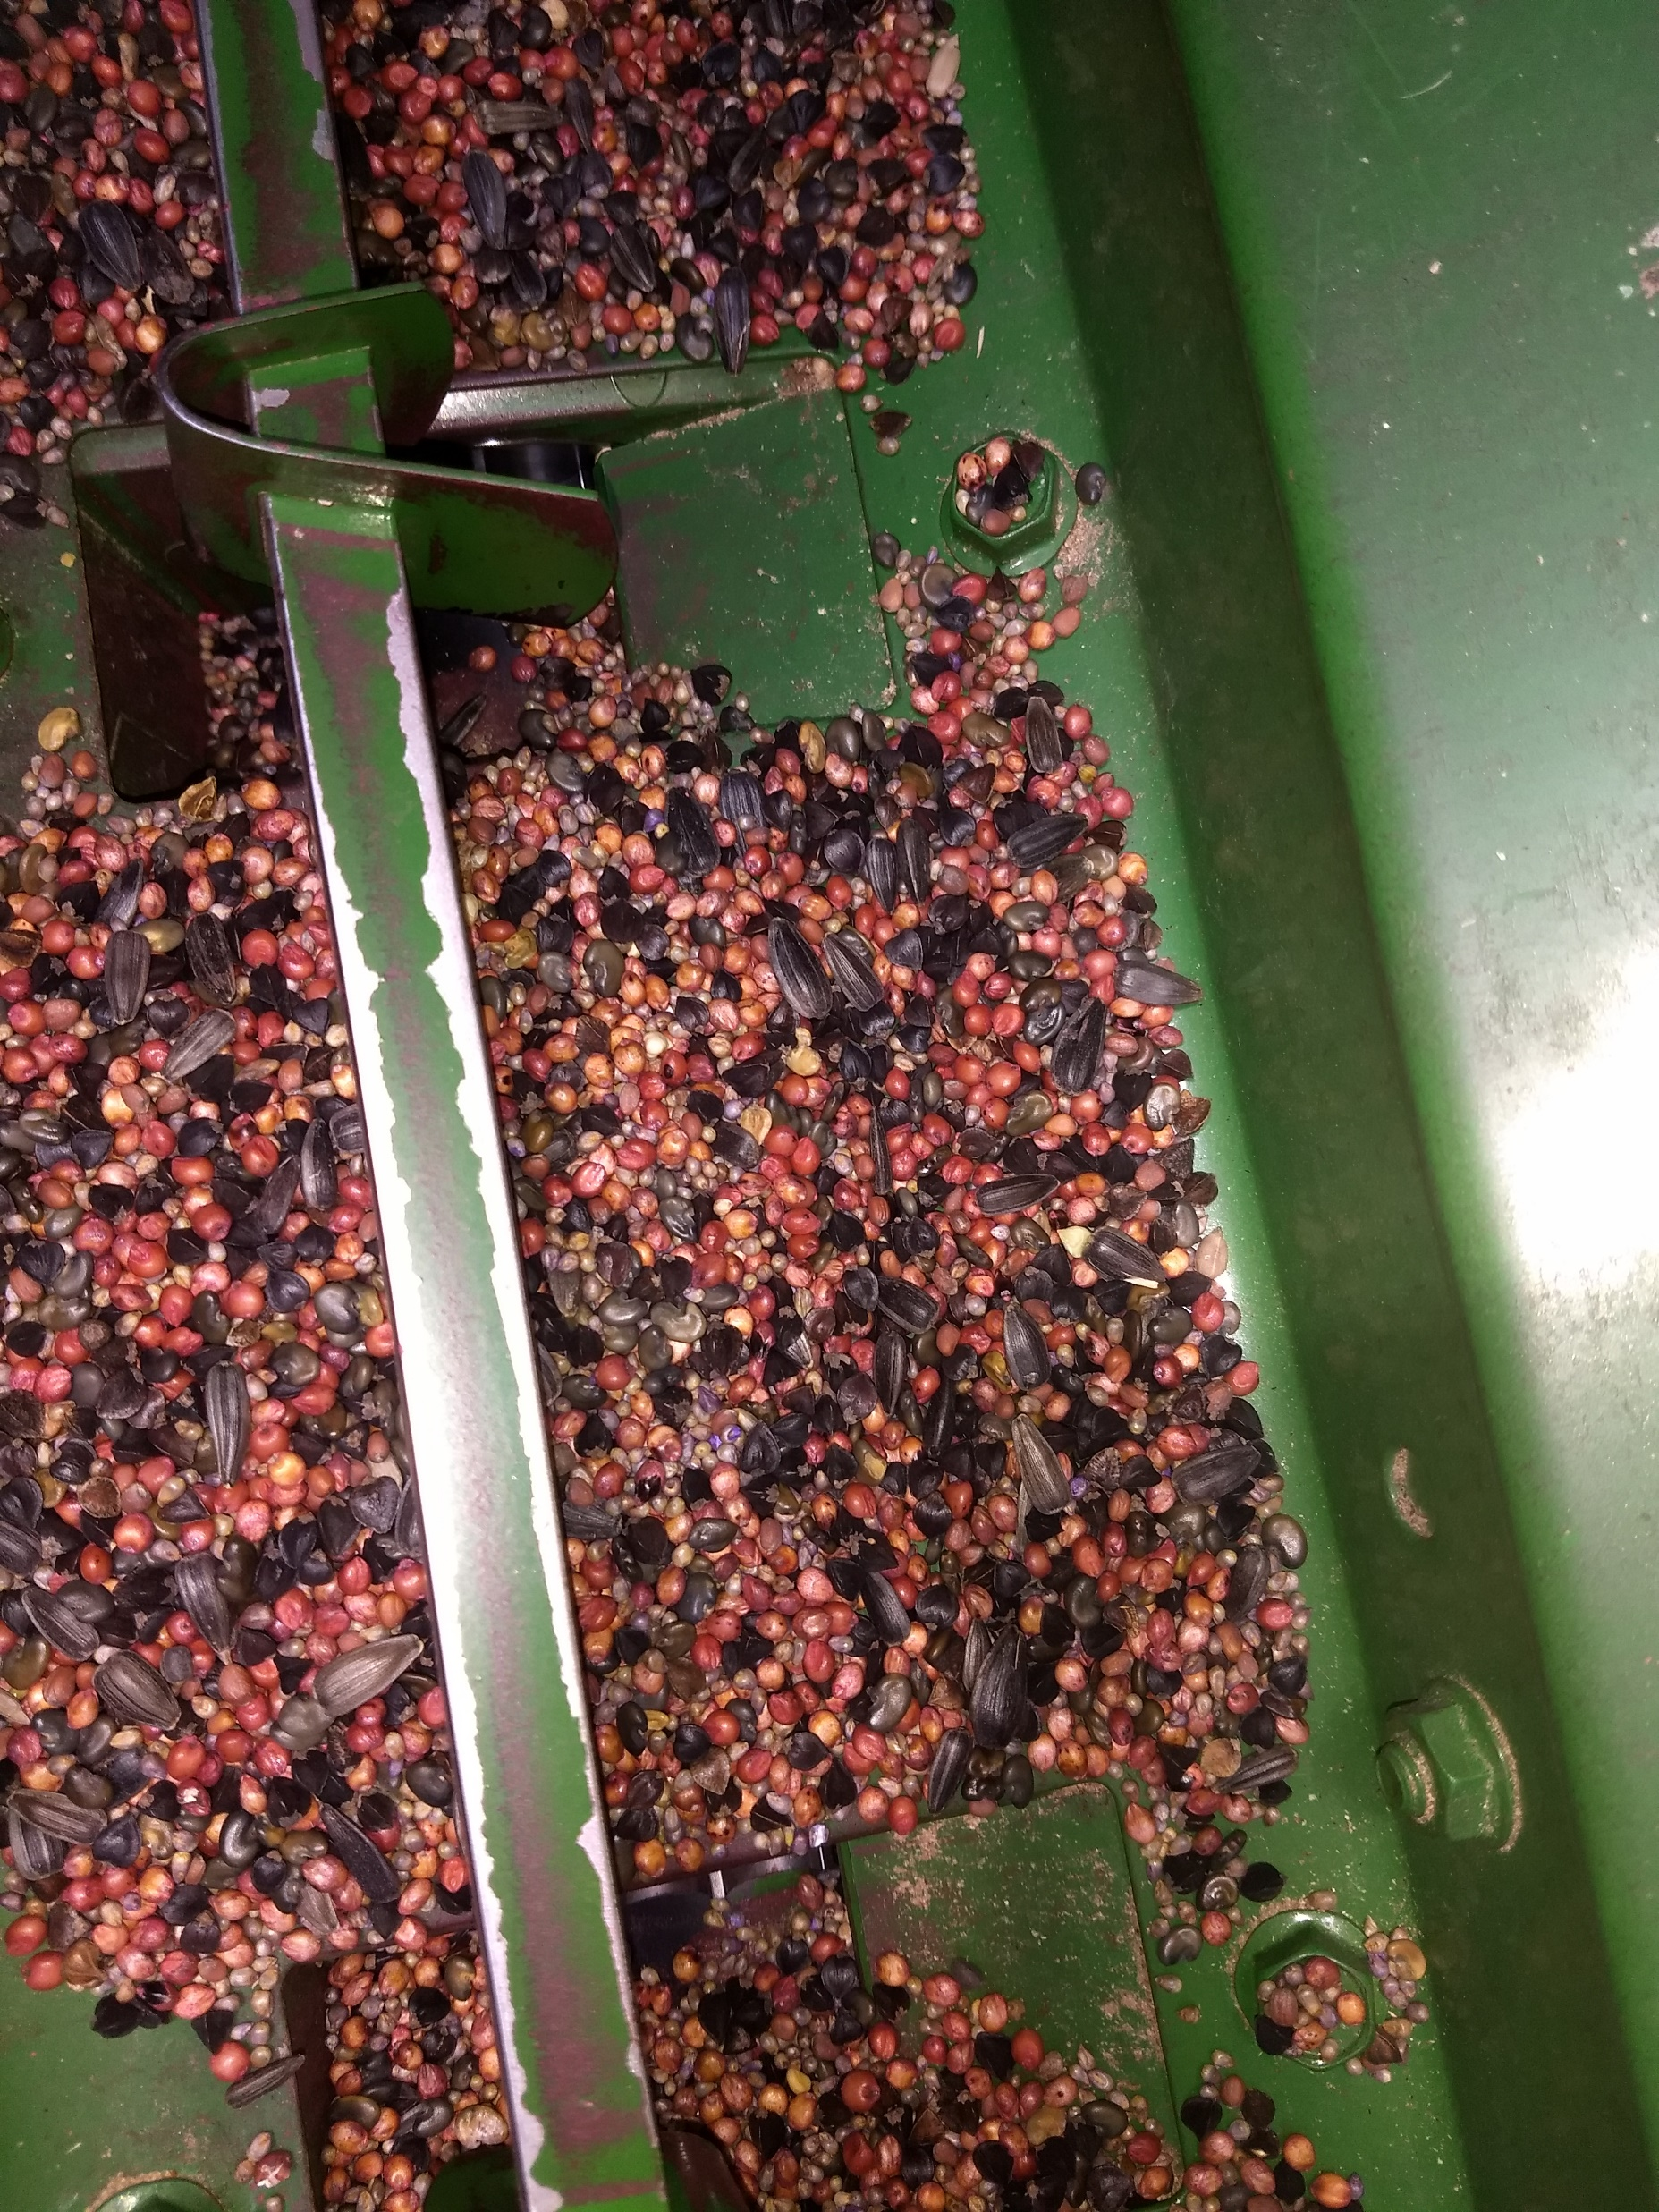
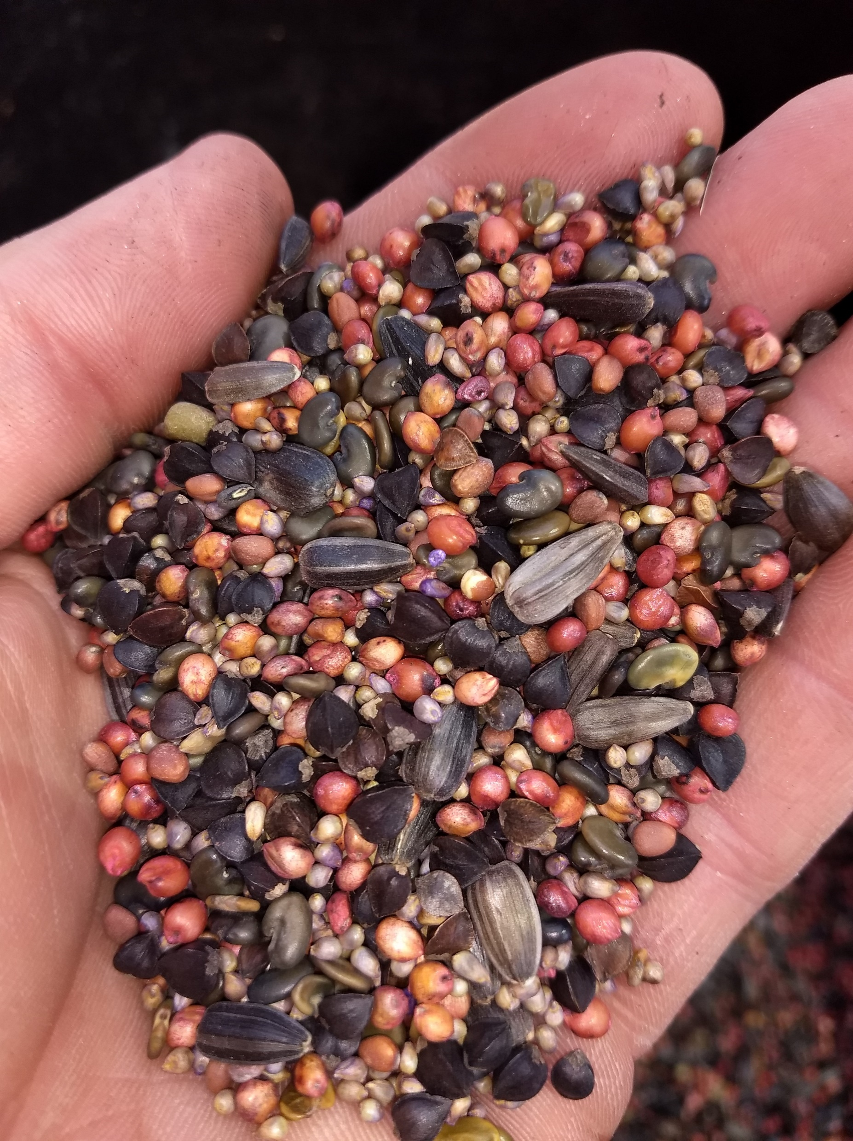
But how do I plant a mix?
Mix settling out
  Diverse seed sizes provide mix stability
Undesirable planting depth
  Most cover crops have similar seed density
  If using multiple seed boxes, observe seed delivery at openers.
Broadcast pattern not uniform
  Select track spacing to seed with lowest density
  Apply seeding stickers to aggregate seed
Notes:
Cover crop seed have a similar seed density (lbs/bu)
Pretty good bullet points to review
This slide addresses common issues or questions about planting cover crop mixes.The first picture is of a common warm season mix containing sunflower, sunnhemp, sorghum, millet, buckwheat that is being loaded into a box drill. The second photo is after a majority of the seed has been planted exposing the bottom of the box drill. Notice that all species are still present in the mix. It is thought that the more species that are in a cover crop mix that the more stable the mix due to different seed sizes filling all voids.

Slide 34
Termination
What is the most common method of cover crop termination in your region?

Slide 35
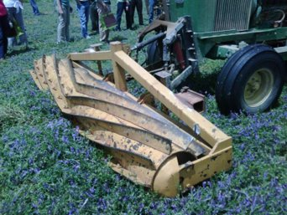
Cover Crop Termination Methods
Herbicide burn down
Frost termination
Crimper / Roller
Grazing
Shredding / mowing
Tillage
Combination of methods
Notes:
List ways of cc kill methods

Slide 36
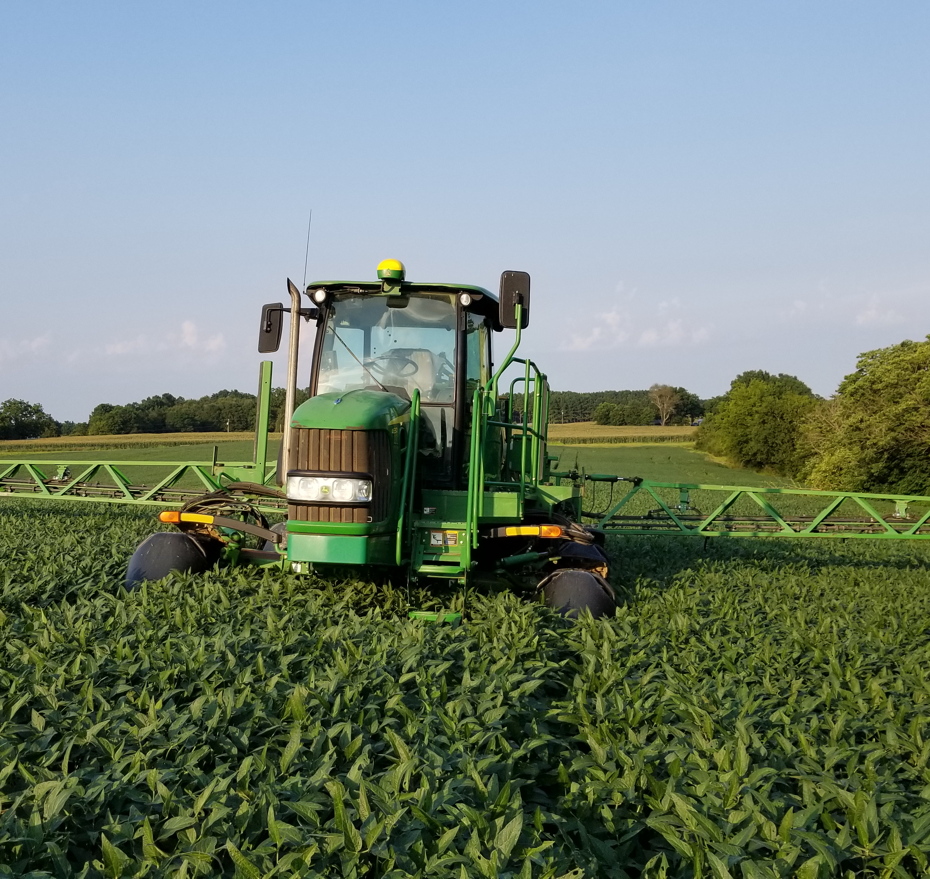
Herbicide Burndown
In the past, specific chemistry was needed to terminate mixed cover crop stands
Implications to next crop provided challenges of chemistry selection
Improved crop genetics allow for more termination tools
  Glyphosate tolerant crops
  Glufosinate tolerant crops
  Dicamba tolerant
  2-4D tolerant
Notes:
Be careful to not use roundup ready cc like canola, you won’t be able to kill it with roundup
This slide covers a topic that was of great concern back in 2007-08. Mixed specie cover crops required multiple herbicide modes to be able to terminate successfully. Those required herbicides could then impact the intended cash crop that was being planted into the cover crop. New technology traits in cash crops have aided in adoption of cover crops due to ease of termination of the cover crops with minimal impact to future cash crops.

Slide 37
Small-scale Conservation Practices:
Cover Cropping
D
E
F
Photos: J. Beniston, USDA NRCS

Slide 38
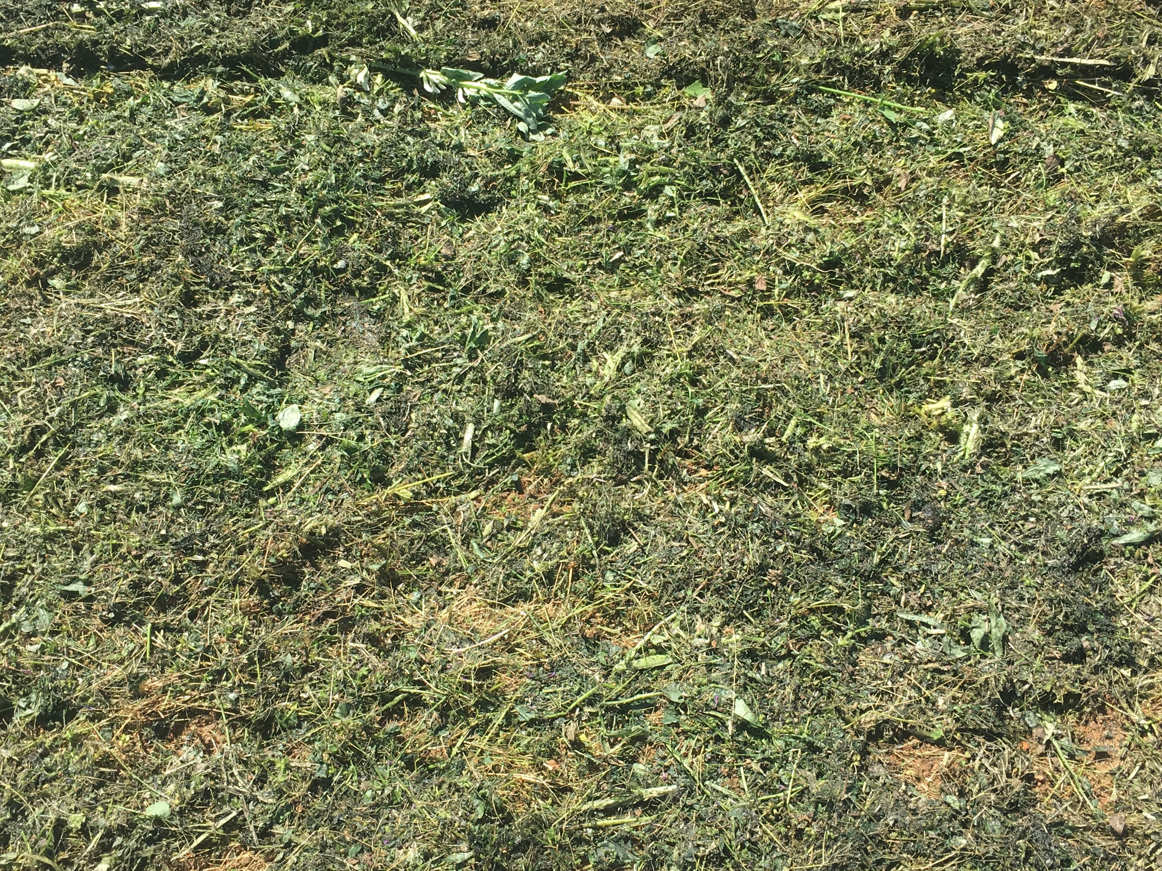
Time of Termination is Key to a number of outcomes:
Soil moisture
Residue amount and breakdown
Timing of operations that follow.

Slide 39
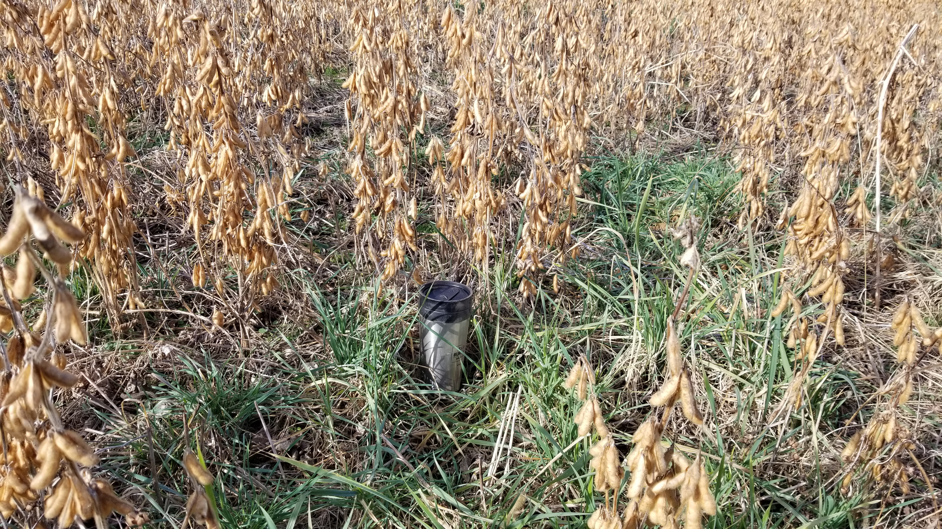
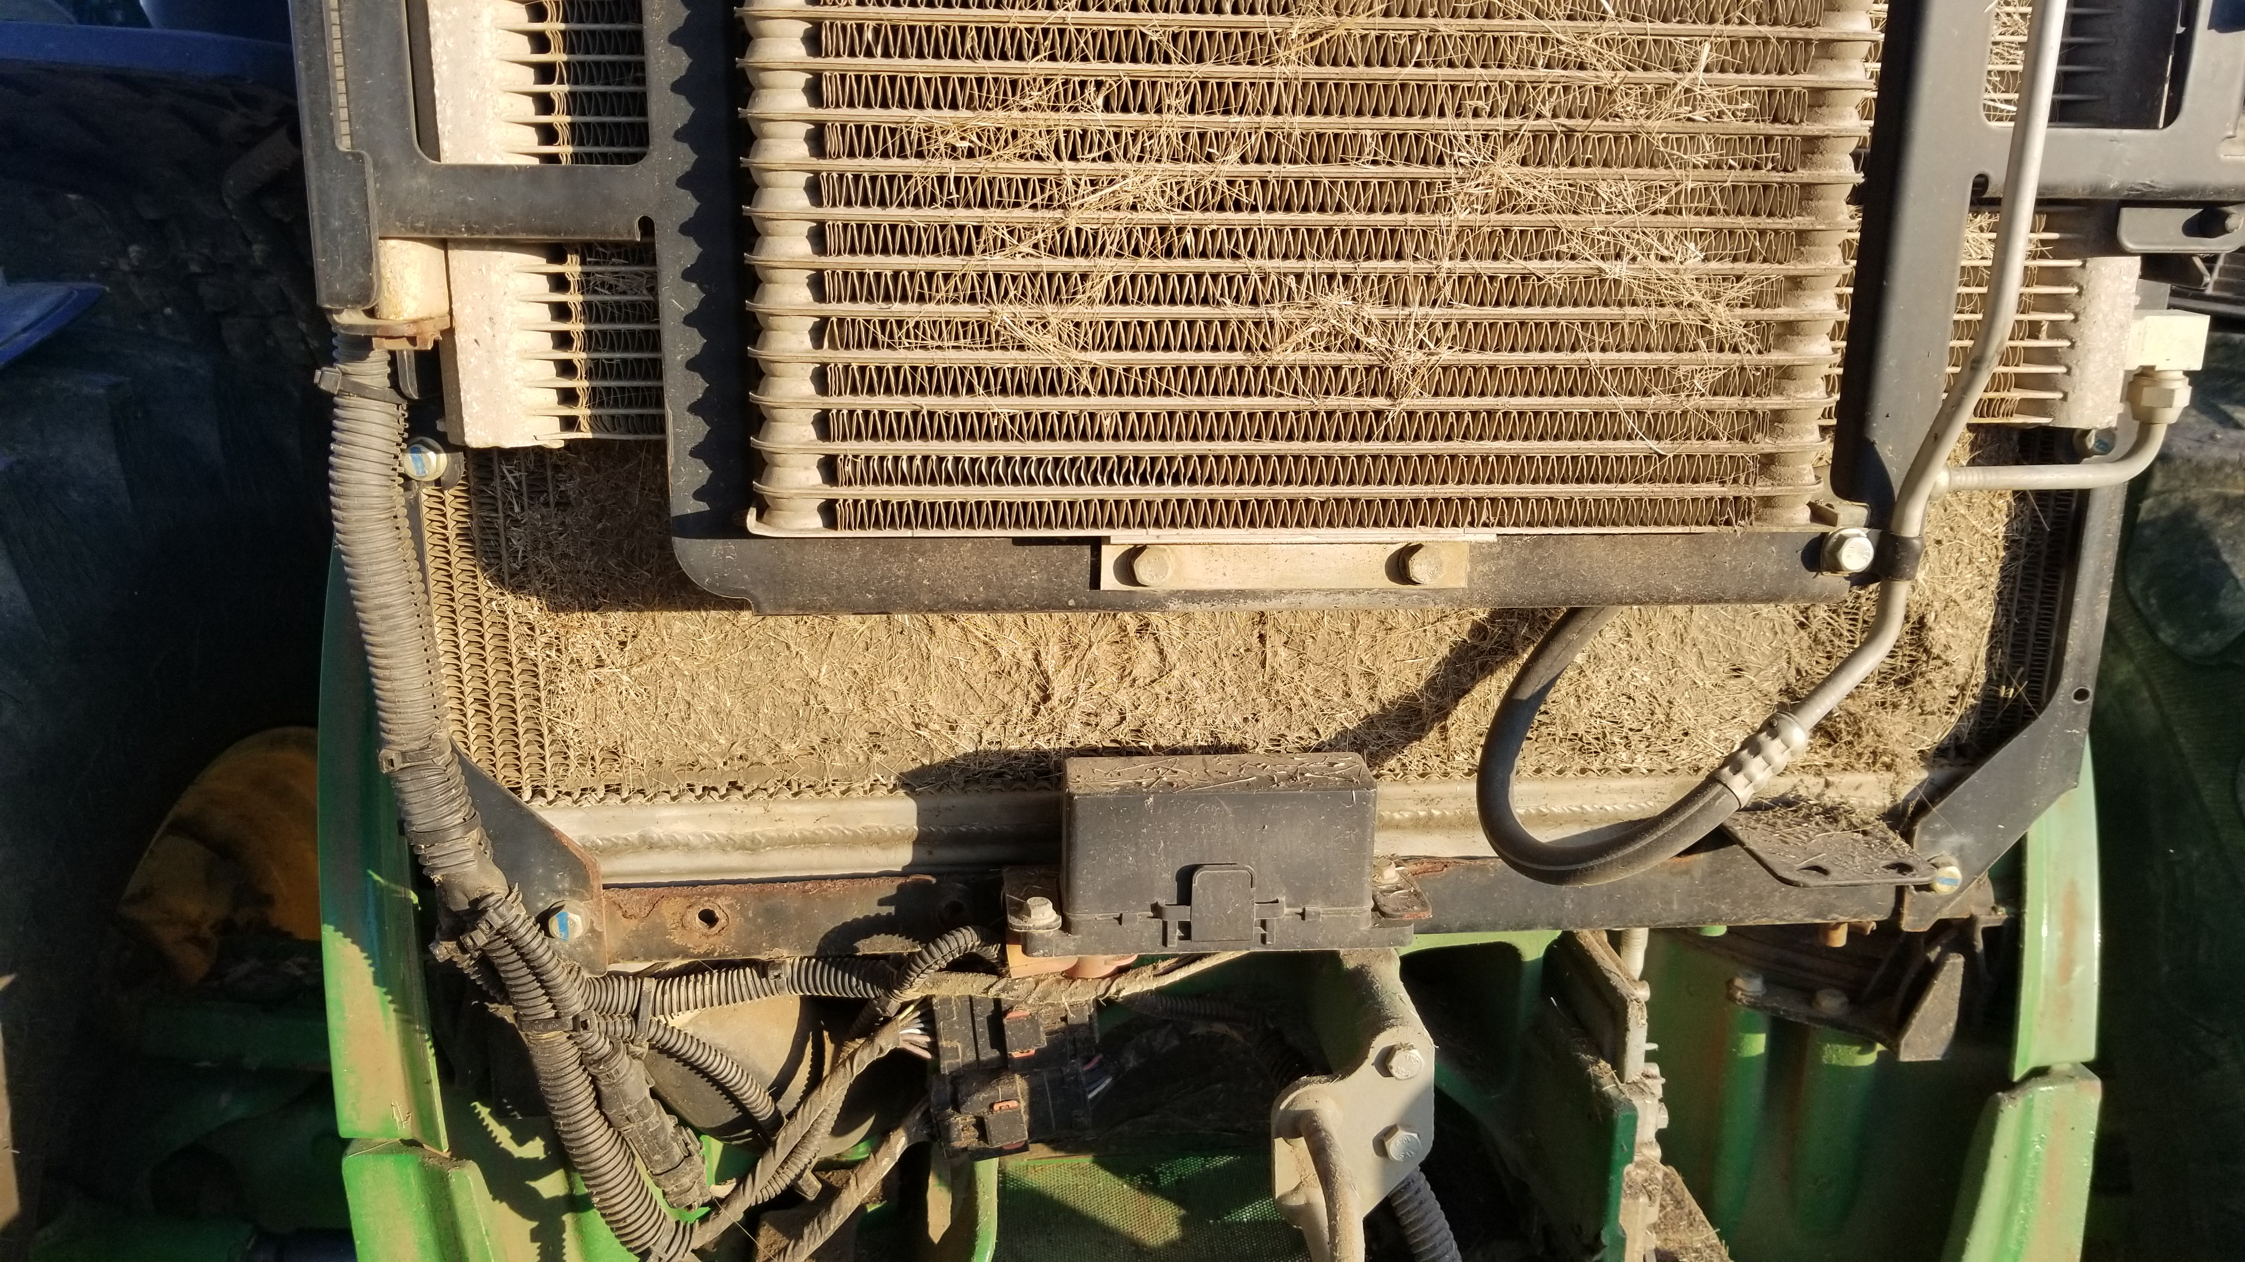
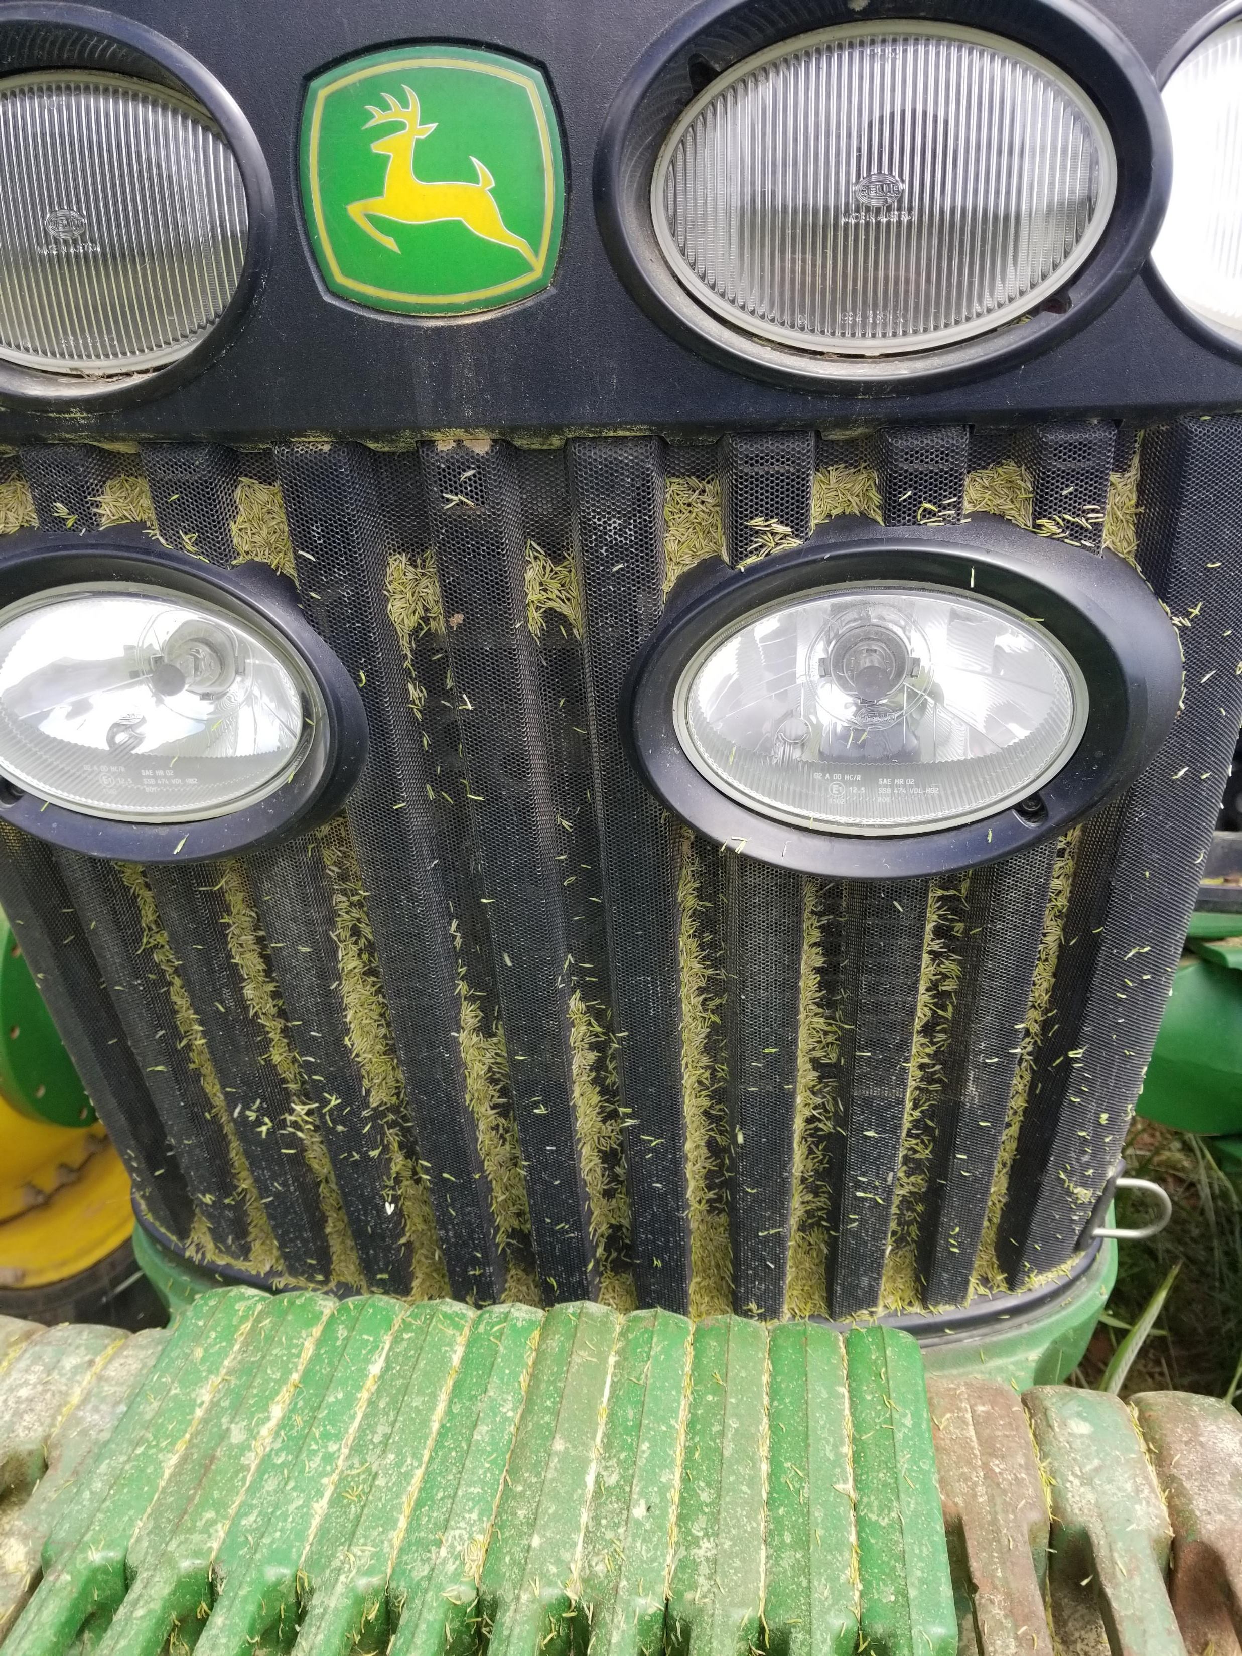
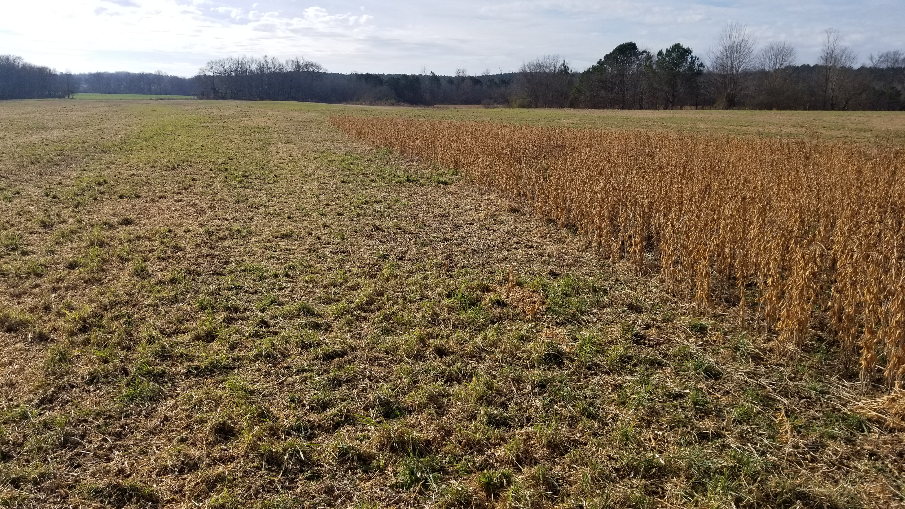
“Plant a cover crop”, they said.
“It will be great!”, they said.
Notes:
There are challenges, you can hide your head in the sand and say it just don’t work in my county or you can work together with a soil health innovator and figure out how to make it work and learn from mistakes.
Photo descriptions:
Top Left – volunteer cover crop in standing soybeans prior to harvest. The prior cover crop was terminated to late after viable seed had been produced. The volunteer cover crop could pose issues with cash crop harvest.
Left Center – the photo is of the radiator of a tractor that was being used to roll down cover crops that were in full bloom. Pollen is abundant and could potentially clog radiator and other cooling system components. Daily maintenance is required to keep equipment cleaned out to avoid issues.It usually is not a problem, just requires daily maintenance.
Bottom Left – Harvest of soybeans with cover crop that volunteered and emerged into cash crop. Excess green material could impact cash crop harvestability and grain sample quality
Top Right – Planter with cover crop residue wrapped around row cleaners on planting unit. This was caused by planting into rolled cover crop the opposing direction.
Bottom Right – Pollen and cover crop residue clogging screens on a tractor rolling cover crop. This could also be observed if producer was planting green.

Slide 40
Group discussion:
Site specific planning
Develop a list of five questions that your group feels are critical to discuss with a producer to begin planning a cover crop system for their site.
Share with larger group

Slide 41
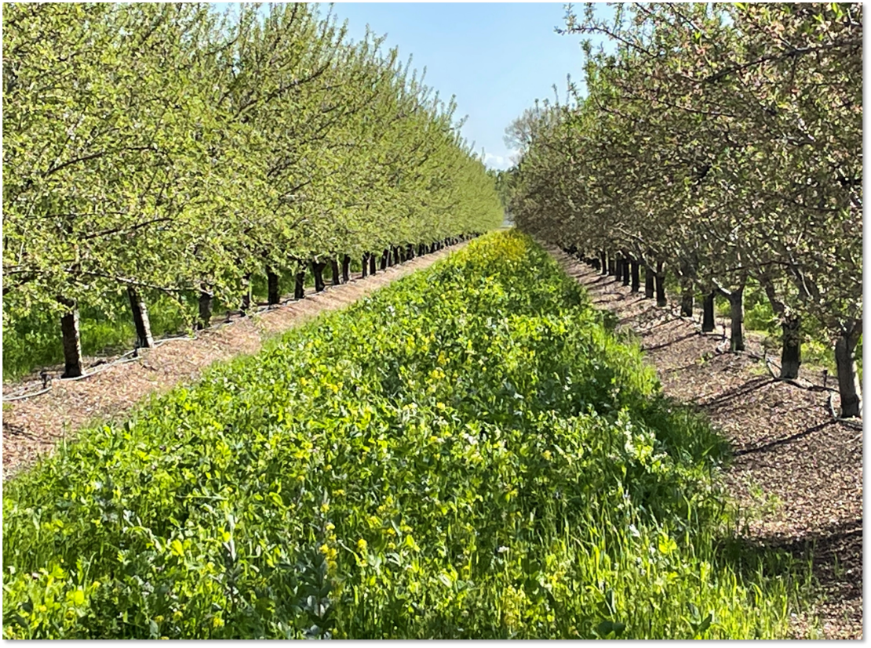
Photo: J. Beniston, USDA NRCS
Notes:
Closing pic showing cc in orchard setting

Slide 42
Questions?
What other components of planning a CC system are important?

Slide 43
Thank you!
For more information on Managing Soil Health,
visit us here:
https://www.nrcs.usda.gov/conservation-basics/natural-resource-concerns/soils/soil-health
USDA is an equal opportunity provider, employer, and lender.

